Slide 1


Git & GitHub Bootcamp 2024
Kevin Wing
wing5640@vandals.uidaho.edu
Introduction to Version Control
Why Git is Essential for Developers
GitHub for Collaboration and Sharing Code
https://github.com/kevinwing/git_bootcamp_2024
Notes:
Start with a brief introduction of yourself and the purpose of the bootcamp.
Have everyone introduce themselves: Name, year and major/work, a little bit about their experience with git/level of git proficiency.
Explain the agenda for the session: first half will be Git basics and command line usage, second half will cover GitHub and common workflows.
Ask participants about their experience with Git/GitHub.

Slide 2
What is Git?
Git is a distributed version control system (VCS)
Tracks changes in your code
Maintains codebase integrity
Allows for multiple developers to work together
Notes:
Introduce Git as a tool to keep track of project history.
Explain what a VCS is and why distributed systems like Git are powerful (mention offline access and no single point of failure).

Slide 3
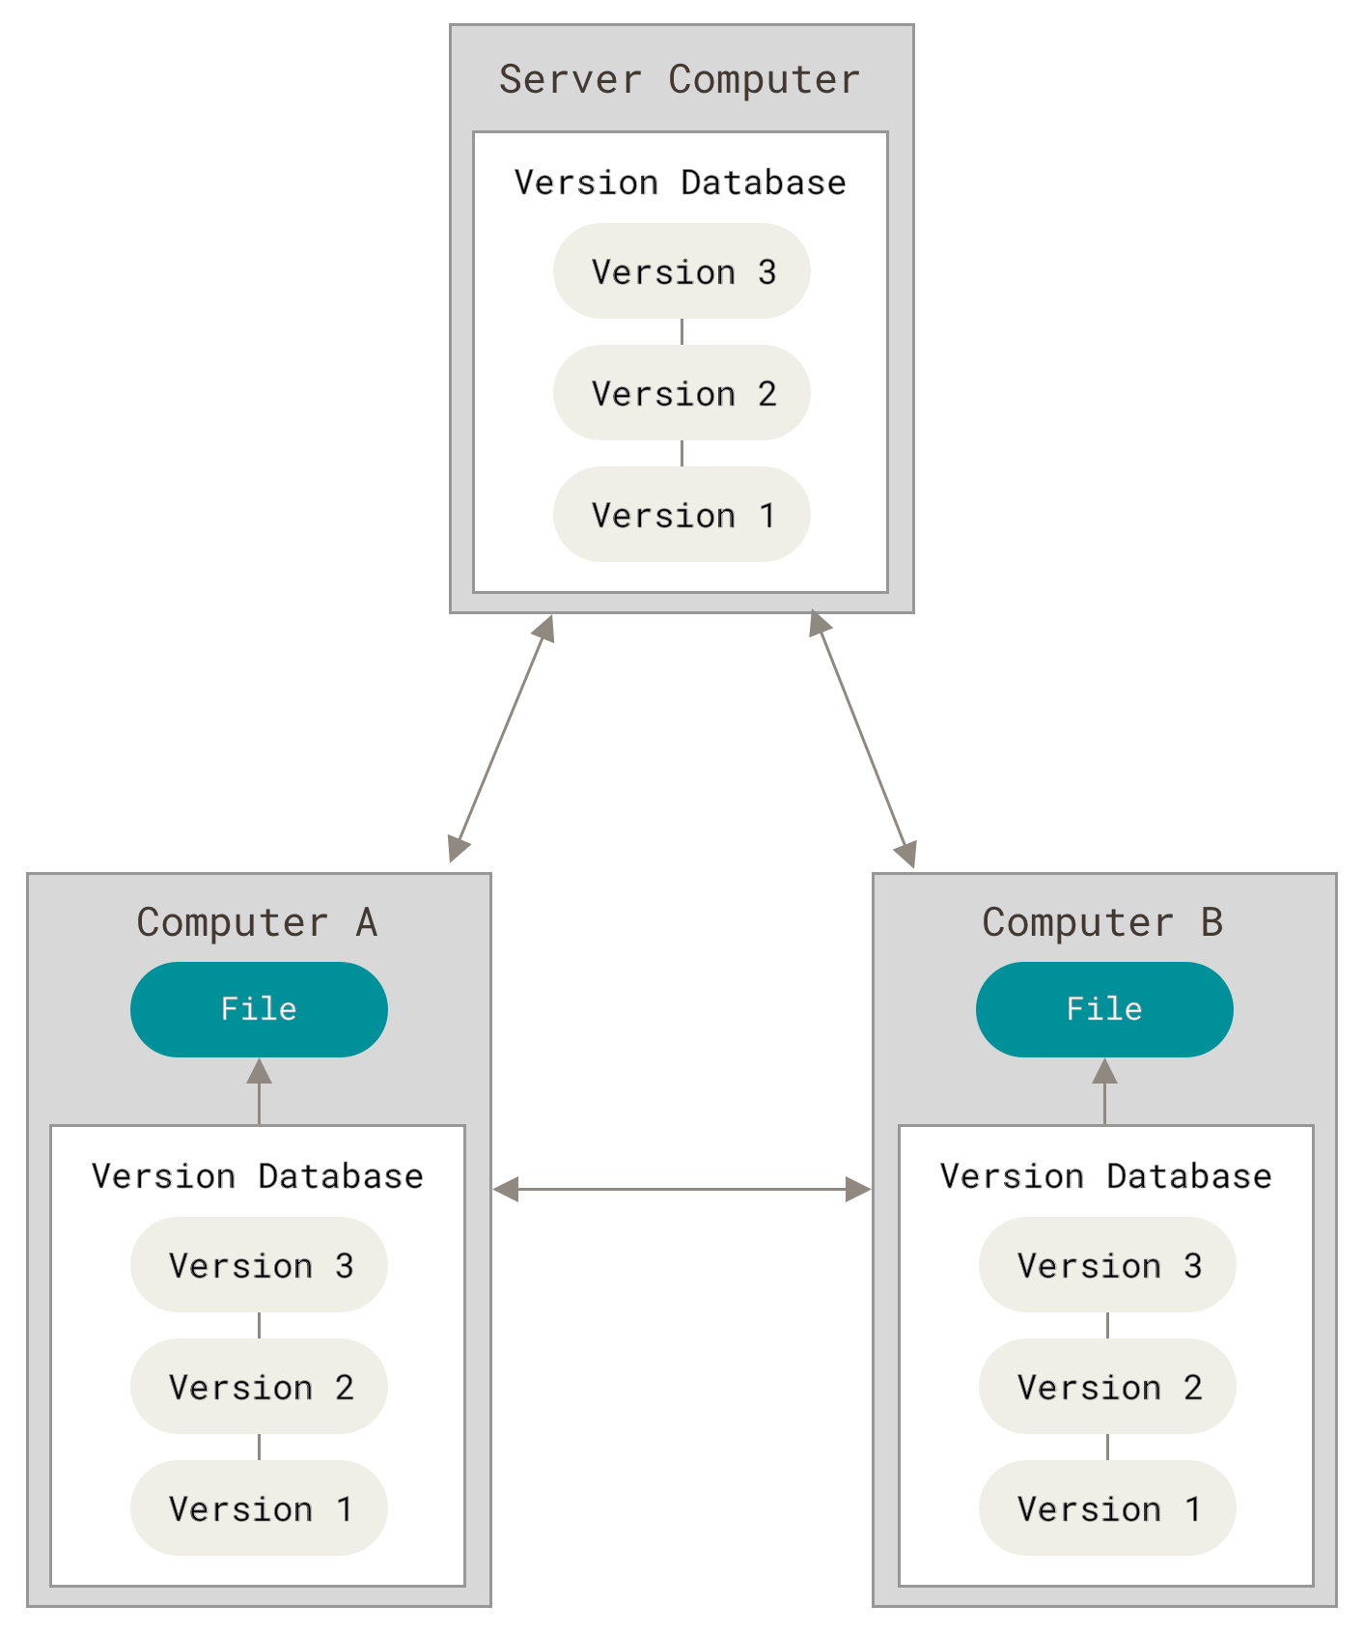
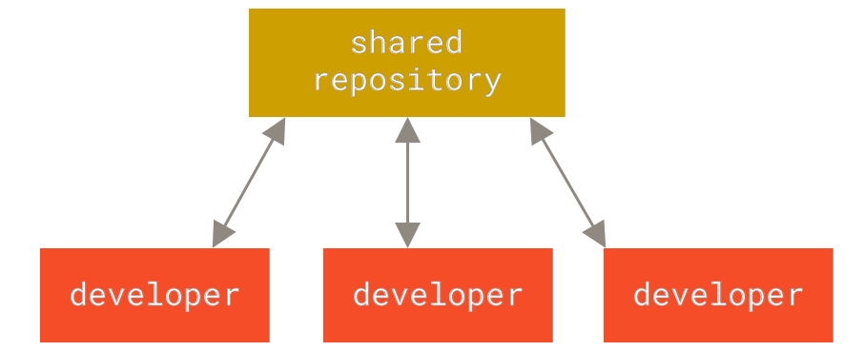
Centralized Vs. Distributed
Centralized
Distributed

Slide 4
Why is it called git?
git
Noun British Slang
A contemptible person
Collins Dictionary
"I'm an egotistical bastard, and I name all my projects after myself. First 'Linux', now 'git'."
Linus Torvalds (Creator of the Linux kernel and git)

Slide 5
Basic Git Concepts
Repository (repo)
Working Directory (where your edits are made)
Staging Area
Commit (snapshot)
Branch (a copy to make some change on)
Merge (joining branches)
Merge Conflicts (sounds scary, but really isn’t)
Notes:
A repository is a directory that is under git tracking
A commit is a snapshot of the code at a given time
Branches allow for parallel development
Merging joins the changes of a particular branch into another
Merge conflicts are when changes in the branch being merged conflict with changes in the branch being merged into.

Slide 6
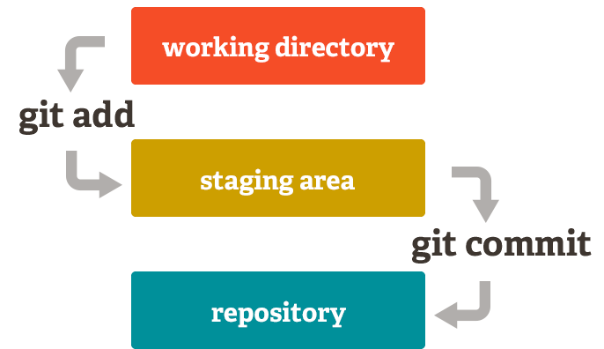
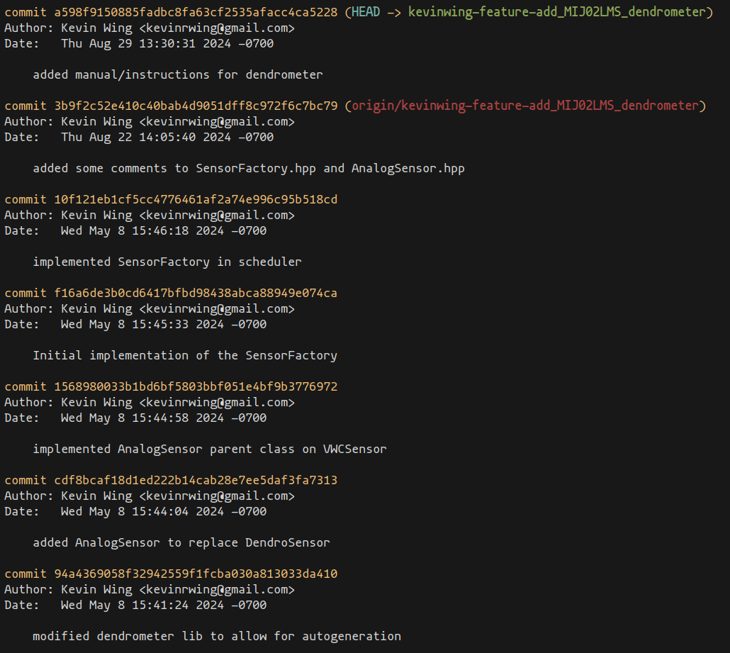
Git Workflow
Working Directory
Staging Area
Commit History
Pushing and Pulling from Remotes repos
Notes:
Walk through the stages of the Git workflow:
Working directory: where you edit files.
Staging area: where you prepare files for commit.
Commit: save changes to local repo.
Push: send changes to a remote repository.
Pull: fetch and merge changes from a remote repo.

Slide 7
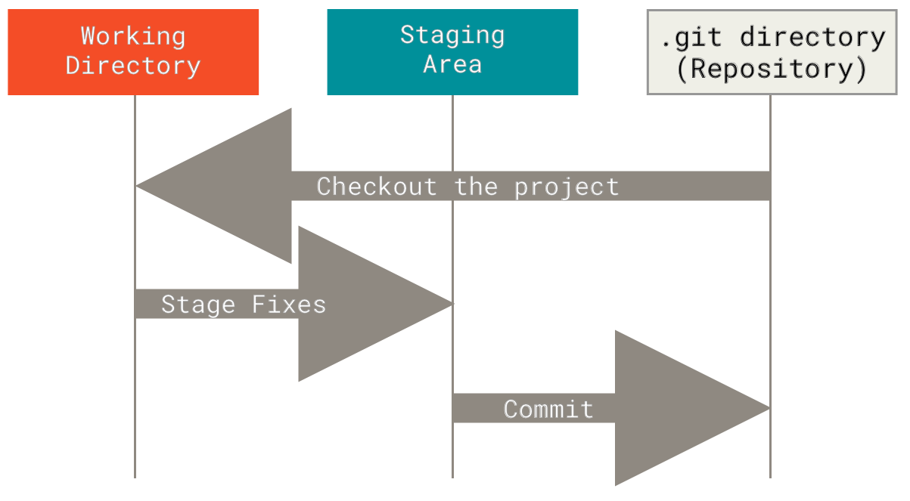
A Better Visual

Slide 8
Common Git Commands
git init
git add
git commit
git status
git log
git push
git pull
git clone
git config
Notes:
Demonstrate each command on the command line with basic examples (e.g., initializing a repo, making a commit, pushing changes).
Encourage participants to follow along by creating their own repository.

Slide 9

What is GitHub?
GitHub is a Cloud-Based Platform for Hosting Git Repositories
Collaboration Tool for Developers
Additional Features: Issues, Pull Requests, GitHub Actions
Notes:
GitHub is built on top of Git.
Collaboration features of GitHub, such as code reviews, issues, and pull requests.
GitHub's role in open-source development.

Slide 10
GitHub Workflow
Fork and/or Clone a Repository
Make Changes Locally (commit)
Push Changes to your Fork
Submit a Pull Request
Notes:
Walk through a typical GitHub workflow using forks and pull requests.
Explain how this allows multiple people to contribute to the same project while keeping the main codebase stable.

Slide 11
Setting Up GitHub
Create account
Setup SSH key
Configure Git on Local Machine
Basic GitHub Settings
Notes:
Show how to create a GitHub account if participants don’t have one yet.
Guide them through the process of setting up SSH keys for secure communication.
Demonstrate setting the name and email for Git (git config commands).

Slide 12
GitHub Features
Pull Requests (PR) and Code Reviews
Issues and Project Management
GitHub Actions
GitHub Pages
Notes:
Provide a high-level overview of additional GitHub features, emphasizing the pull request (PR) process and code reviews for collaborative development.
Touch on GitHub Actions for automating workflows (optional demo if time permits).

Slide 13
GitHub Workflow Demo
Fork a Repository
Create a branch and Make a Change
Submit a PR
Merge a PR

Slide 14
Pull Requests (The Magic of GitHub)
What is a Pull Request (PR)
A request to merge changes into another branch or repository
Why Use PRs?
Enables code review and feedback before merging
Ensures quality and consistency in the codebase
Common Workflow
Fork or clone a repository
Create a new branch for changes
Push changes to your branch/fork
Open a PR to the original repo or main/master branch
Merging PRs
Can be merged once reviewed and approved
Can resolve conflicts during the merge process
Notes:
Explain the collaborative nature of pull requests, especially in large teams or open-source projects.
Walk through a typical workflow of creating a feature on a new branch, pushing it to GitHub, and then opening a PR.
Highlight the benefits of pull requests for quality control and code review.
If time allows, demonstrate opening a PR on GitHub and show the interface where reviewers can add comments and suggest changes.

Slide 15
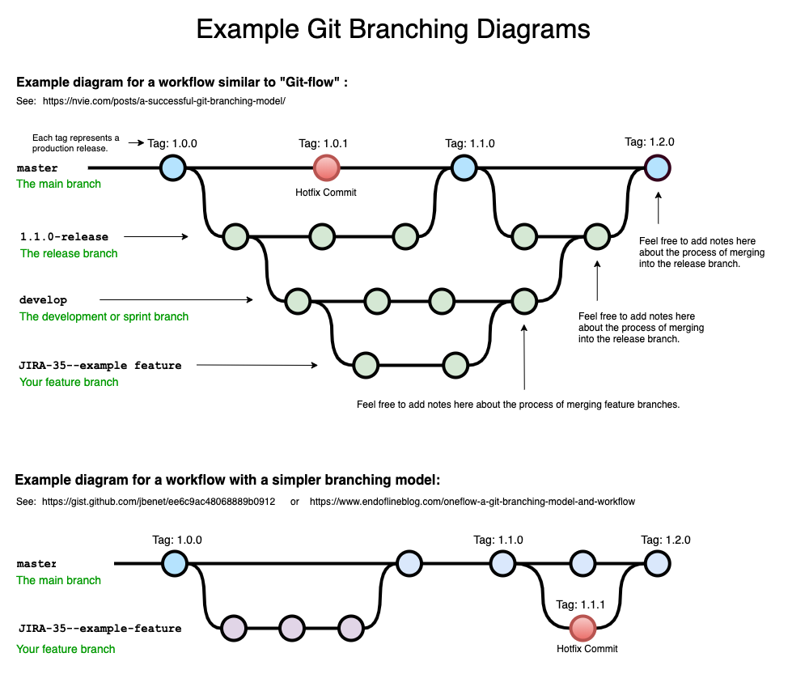
Git Branching
Creating and Switching Branches
Merging Branches
Handling Conflicts
Notes:
Explain the importance of branching for feature development and how it keeps the main codebase clean.
Demonstrate how to handle merge conflicts, emphasizing it’s a common situation in collaborative work.

Slide 16
Best Practices for Git & GitHub
Commit Often with Meaningful Messages
Keep Branches Organized
Use PRs for Code Review
Sync Local Branches with Remotes Regularly
Notes:
Provide tips for using Git and GitHub effectively in a team.
Explain the importance of meaningful commit messages and frequent commits to track progress.

Slide 17
With Great Power…
git reset: Can rewrite history, be careful
git checkout - - <file>: Discards changes permanently
git push - -force: Can overwrite remote history
git rebase: Rewrites commit history, use with caution
git clean: Deletes untracked files permanently
Notes:
Some Git commands, while powerful, should be used with caution because they can result in the loss of work or changes.
git reset is often used to undo changes, but it can also remove commits permanently if not used properly.
git checkout -- <file> will discard all changes to a file in the working directory, which is irreversible.
git push --force as it can overwrite history on a shared repository, potentially affecting team members' work.
git rebase alters commit history, which can create problems if done on shared branches.
git clean is used to remove untracked files and directories, but it should be used carefully since deleted files can’t be recovered by Git.

Slide 18
Q & A
What is something we did not go over that you would like to know more about?
Any issues with setup?

Slide 19
Final Thoughts
Git and GitHub are Essential for Software Development
Keep Practicing
Plenty of Resources
https://git-scm.org/doc
https://docs.github.com
etc.

Slide 20
References
Wikipedia contributors. "Git." Wikipedia, The Free Encyclopedia. Wikipedia, The Free Encyclopedia, 5 Sep. 2024. Web. 24 Sep. 2024.
Git - Documentation. git-scm.com/doc.
“GitHub.com Help Documentation.” GitHub Docs, docs.github.com/en.
“Drawing Git Branching Diagrams.” Bryan Braun - Frontend Developer, 24 Apr. 2020, www.bryanbraun.com/2020/04/24/drawing-git-branching-diagrams.

